Slide 1
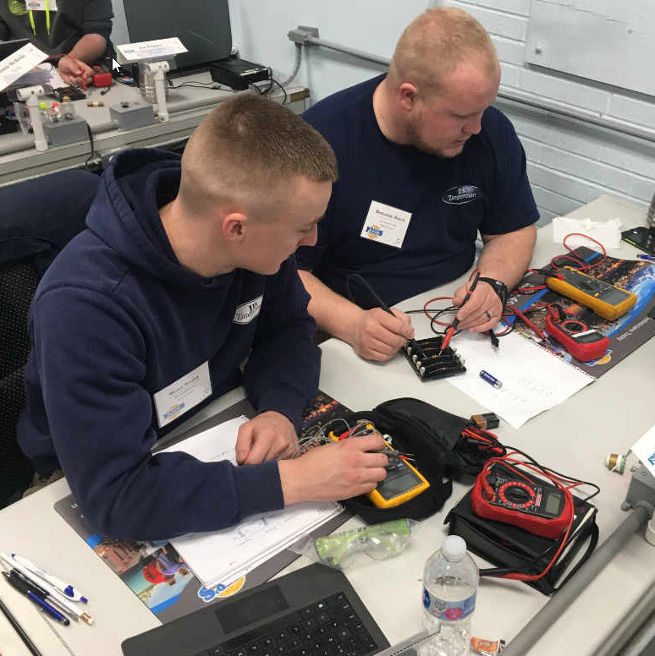
Training a New Hire
Technician
CONVENTION 2022

Slide 2
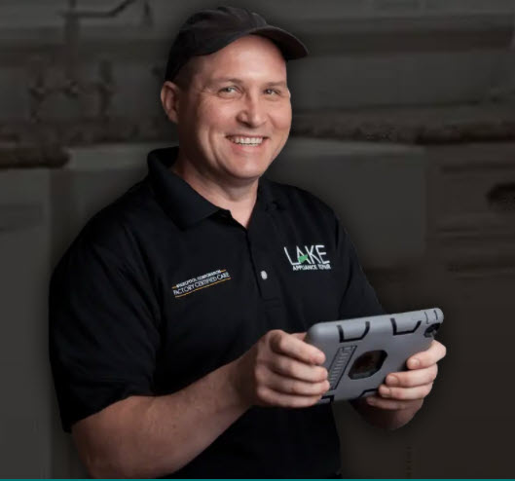
Onboarding Complete
Candidate Interview Attributes
Presents well, Customer Service Attitude, Mechanical Aptitude
Set Job Expectations in the Job Description or in a separate document
Ride to decide
Maintain a warm bench strategy

Slide 3
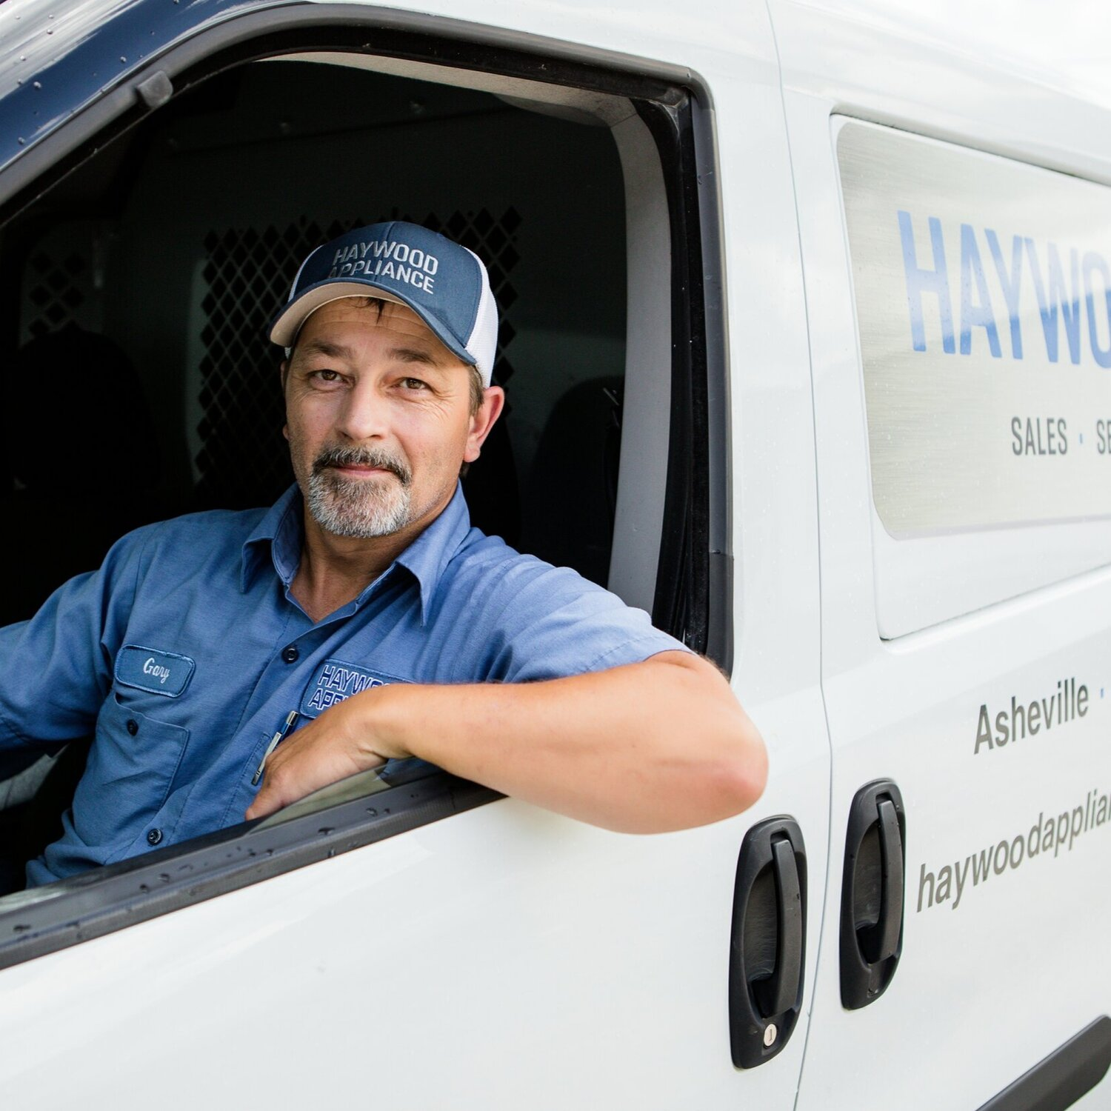
Ease them into the company
Ride along
Second man helper
Delivery prep
Evaluate
Personality
Punctuality
Follow instructions
Are they the right candidate
before you spend the money
What’s their VARK?

Slide 5
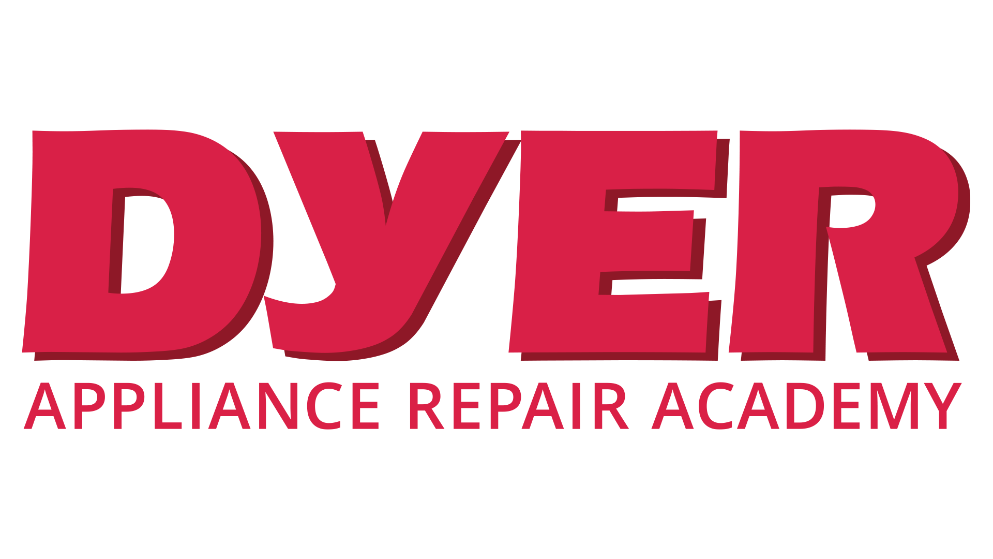

Slide 6
Master Samurai Tech
Online Training and Tech Support
www.MasterSamuraiTech.com
www.Appliantology.org
Structured training courses
with quizzes and exams.
Appropriate for all levels.
Day-to-day support:
Tech-only Forums, access to service manuals, continuing ed videos.
www.MasterSamuraiTech.com/Brandsource

Slide 7
Master Samurai Tech
Online Courses Offered
• Core Appliance Repair Training
• Advanced Refrigerator Repair
• Advanced Oven & Range Repair
• Advanced Washer, Dryer and Dishwasher Repair
Advanced Troubleshooting
Delivering Professional Service (soft skills short course)
For CSRs: 5-Star Customer Support
Available individually or in cost-saving bundles.
BrandSource member discount: 15%
Full tech training as low as $1526 (member pricing)
www.MasterSamuraiTech.com/Brandsource

Slide 8
Master Samurai Tech Training
How the Courses Work
• On-demand
• Self-paced
• Mix of text and video
• Quizzes and Exams
• Individual help in Forums
• Certification available for high-performing students
www.MasterSamuraiTech.com/Brandsource

Slide 9
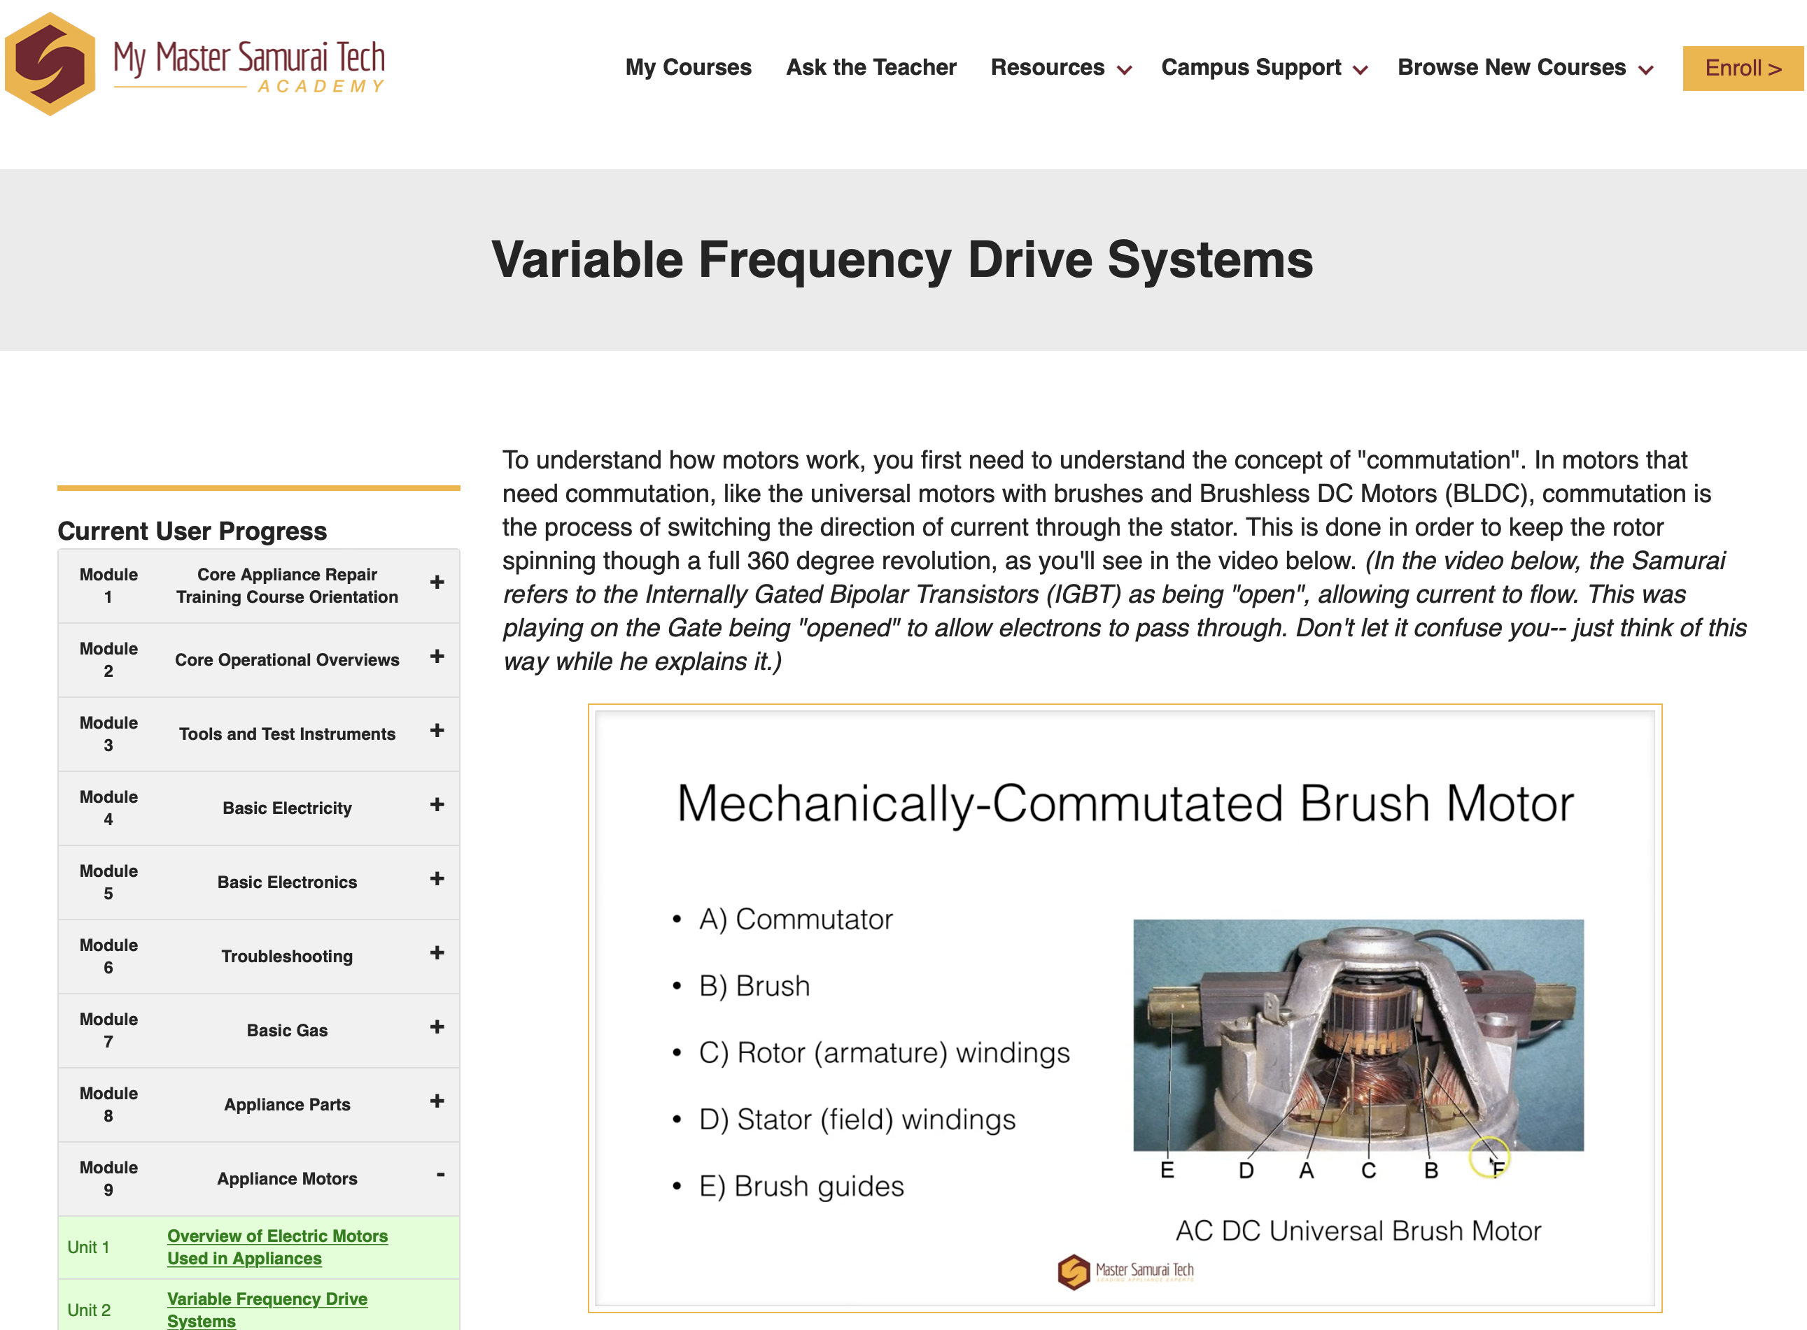
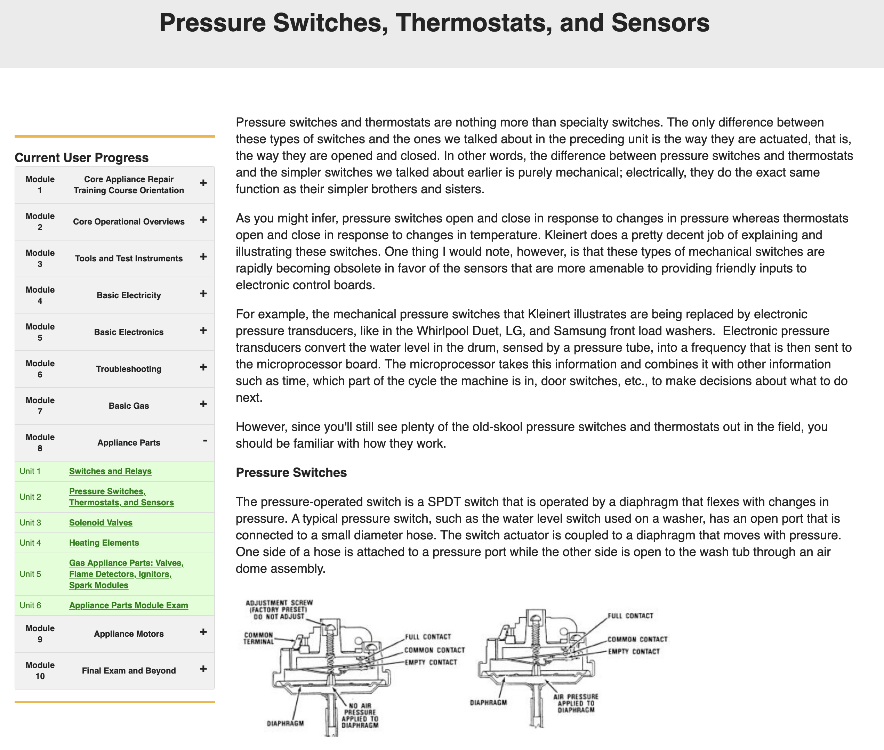
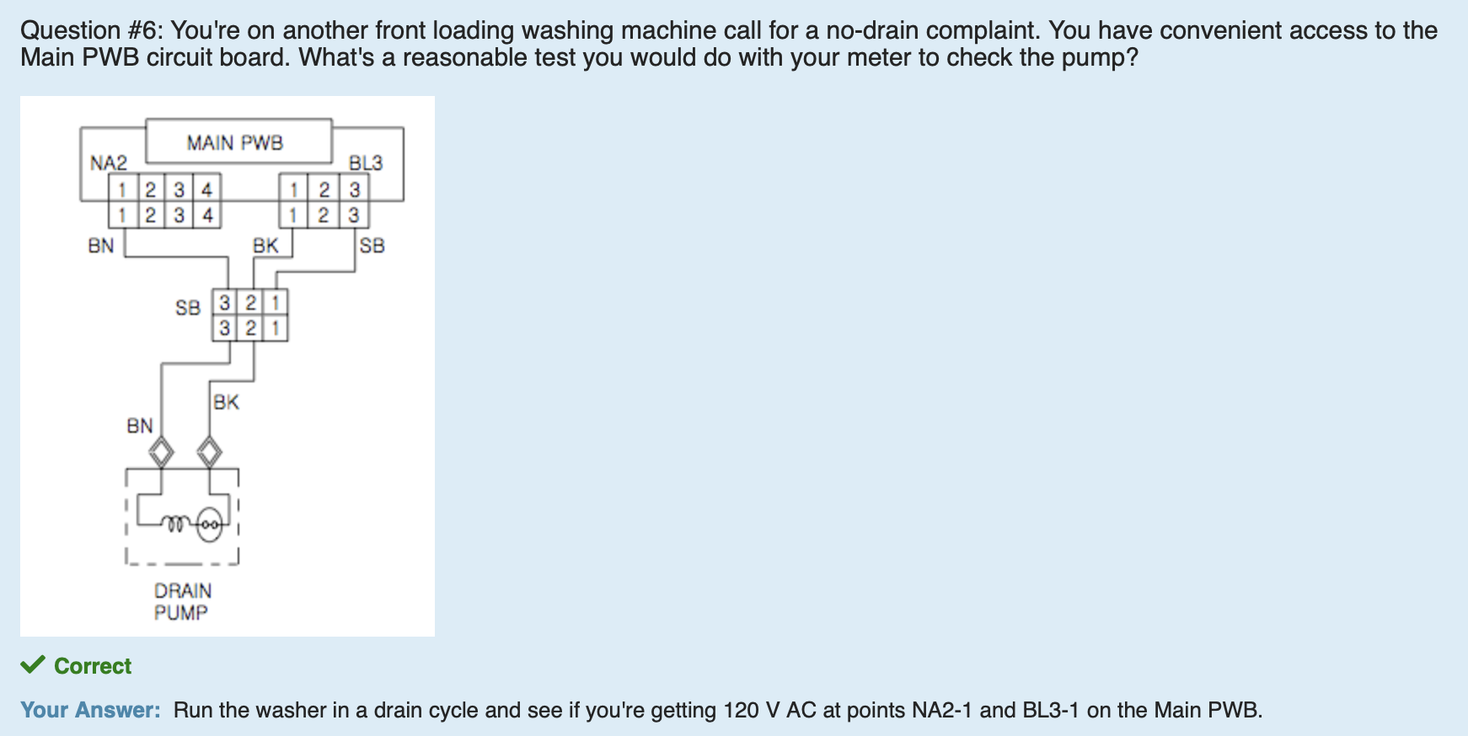
Master Samurai Tech Training
How the Courses Work
www.MasterSamuraiTech.com/Brandsource

Slide 10
How to Build a Tech
Online training + Hands-on practice
Courses: Spend time each week working on the online courses. Ideally a couple of hours per day. But this is flexible!
Hands-on Practice: Ride-along or shop work to practice what they are learning and pick up easy revenue generating skills.
Continuing Education: Use Appliantology.org to keep learning and get day-to-day job support.*
*MST Students get an initial free membership at Appliantology, followed by free or discounted membership for life

Slide 11
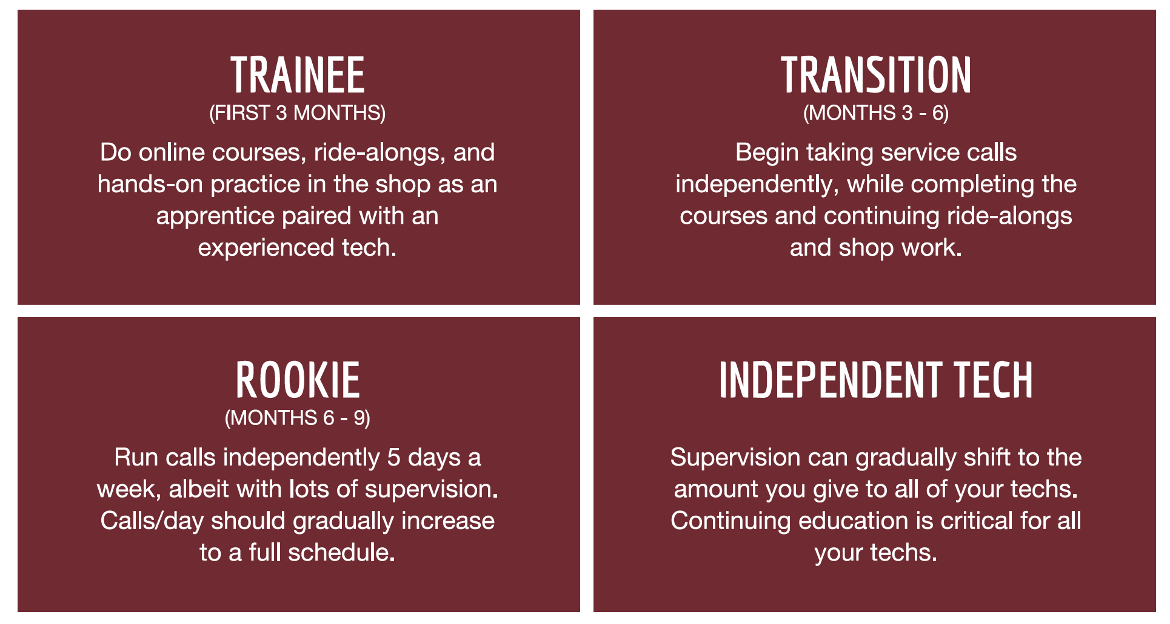
How to Build a Tech
Timeline
www.MasterSamuraiTech.com/Brandsource

Slide 12
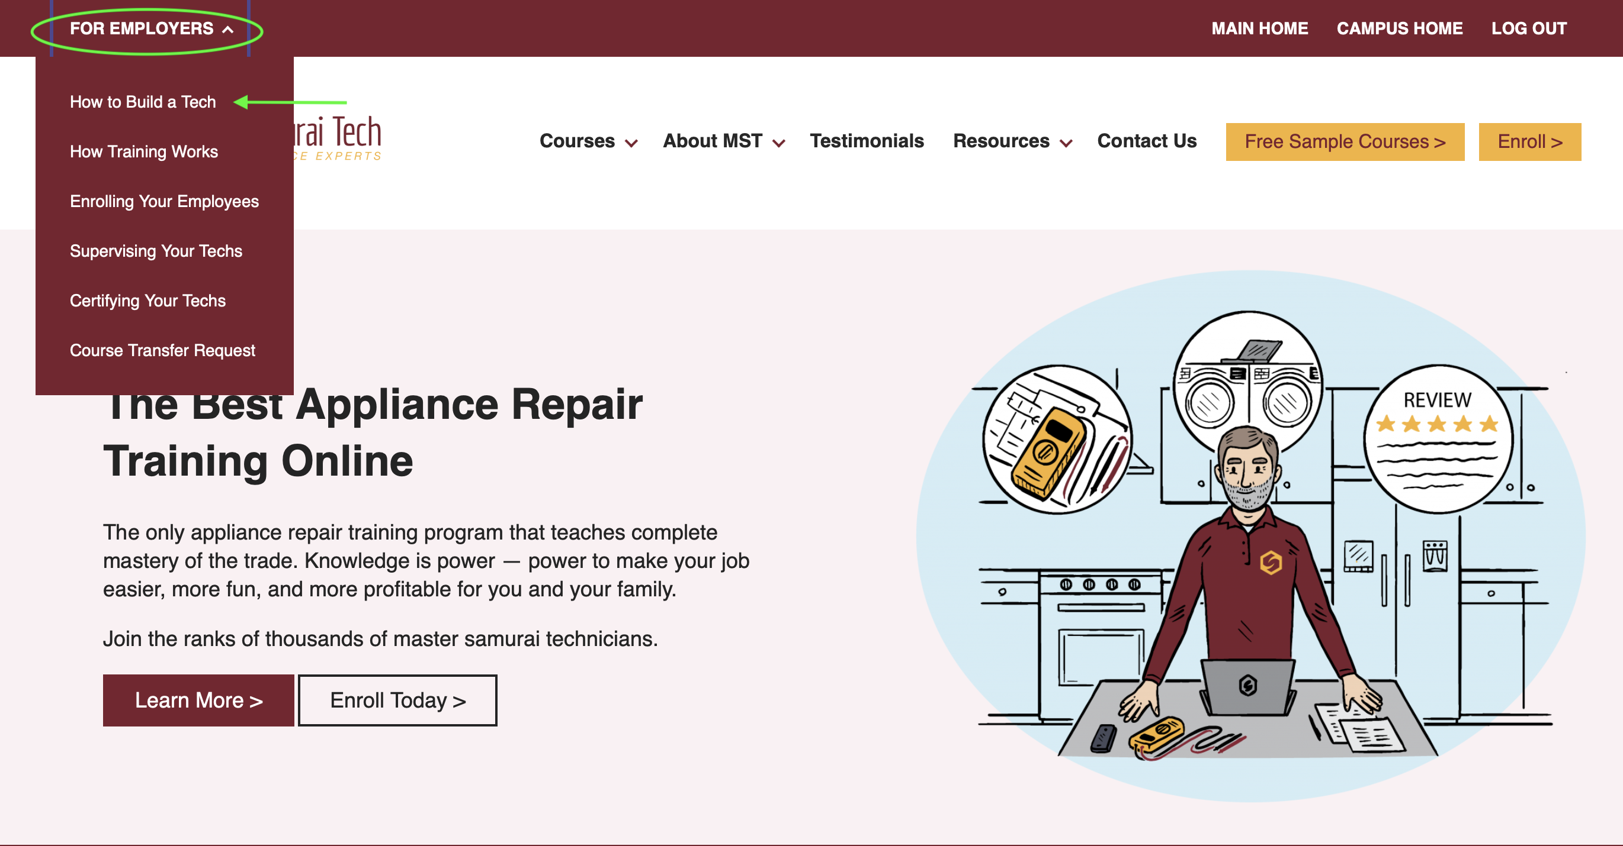
How to Build a Tech
E-Book
www.MasterSamuraiTech.com/Brandsource

Slide 13
BrandSource Discount
www.MasterSamuraiTech.com/Brandsource

Slide 14
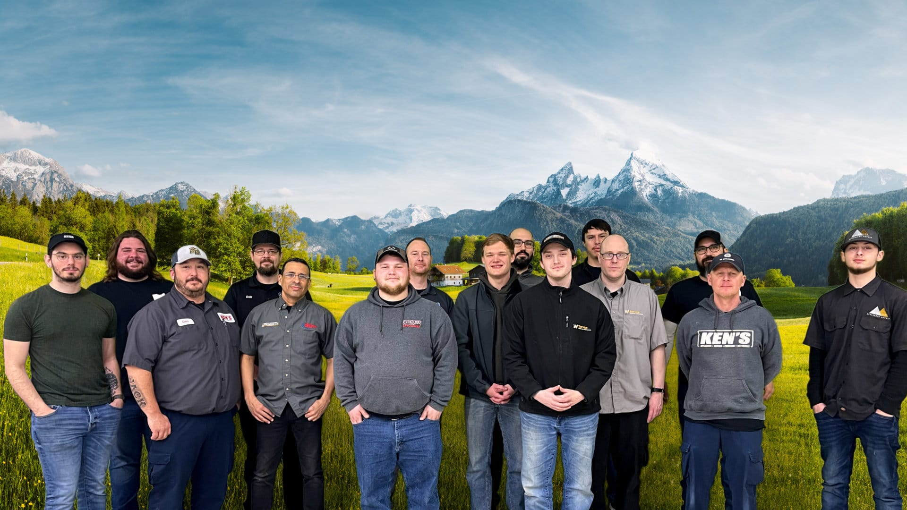
Training Process at Fred’s Appliance Service
Recruitment
Pre-screen/Interview
Online Training
Weeks 1 - 4
Fred’s Appliance Academy Hands On 3 Week Course
Weeks 4 - 12
Typically a 4-6 month process. Requires a great deal of flexibility with training as each candidate is different. Some that learn slower than others can still have success in the field, any trainer in this field has to adapt their training process to coach and work these changes.
The best way to determine a candidate's skill set is by placing them in the best position to demonstrate their current aptitude for each skill in your actual operation. Based on what you deem to be acceptable, the candidate can progress and the company continues to test their skills throughout the training process.
We also share a more specific process here: https://academy.fredsappliance.com/general/learn-how-to-hire-and-train-your-field-team/

Slide 15
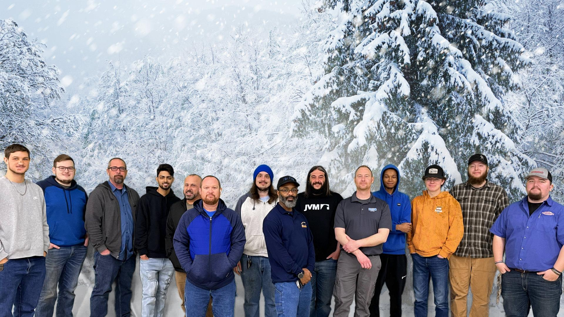
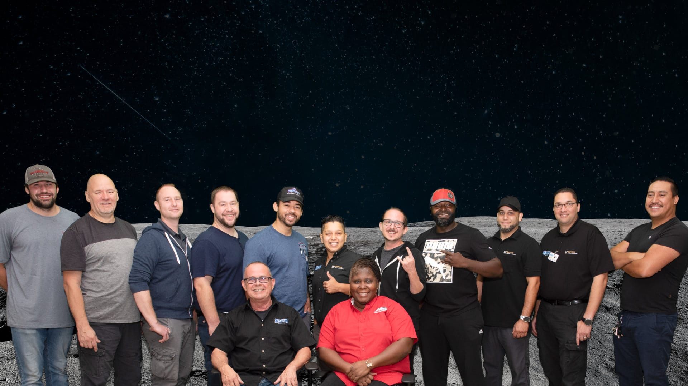
Using Fred’s Academy Online Training with new hires
Onboard candidate to each online course at Fred’s Appliance Academy
We recommend completing half of the available online training before sending a candidate to our hands-on training, but this can vary by candidate and availability of the hands-on course.
Each individual online course takes around 10 clock hours to complete
Bundles compound clock hours, example: Gas and Electric Dryers course bundle would be 20 hours
Completing half of the training would be around 40 clock hours to complete
Washers/Dryers/Refrigerators/Ranges/Microwaves/Dishwashers
No set deadlines as we want to see how candidates will engage with each self paced course and we check in once a week on how they are progressing through the online material.
Ideally candidates should be learning during downtime but we can schedule designated time for them to learn the training.
How much does the candidate want to learn? How are they understanding the material?
Is any of the online material being applied on the road while riding with a senior tech? This requires communication between management and the trainer/senior tech

Slide 16
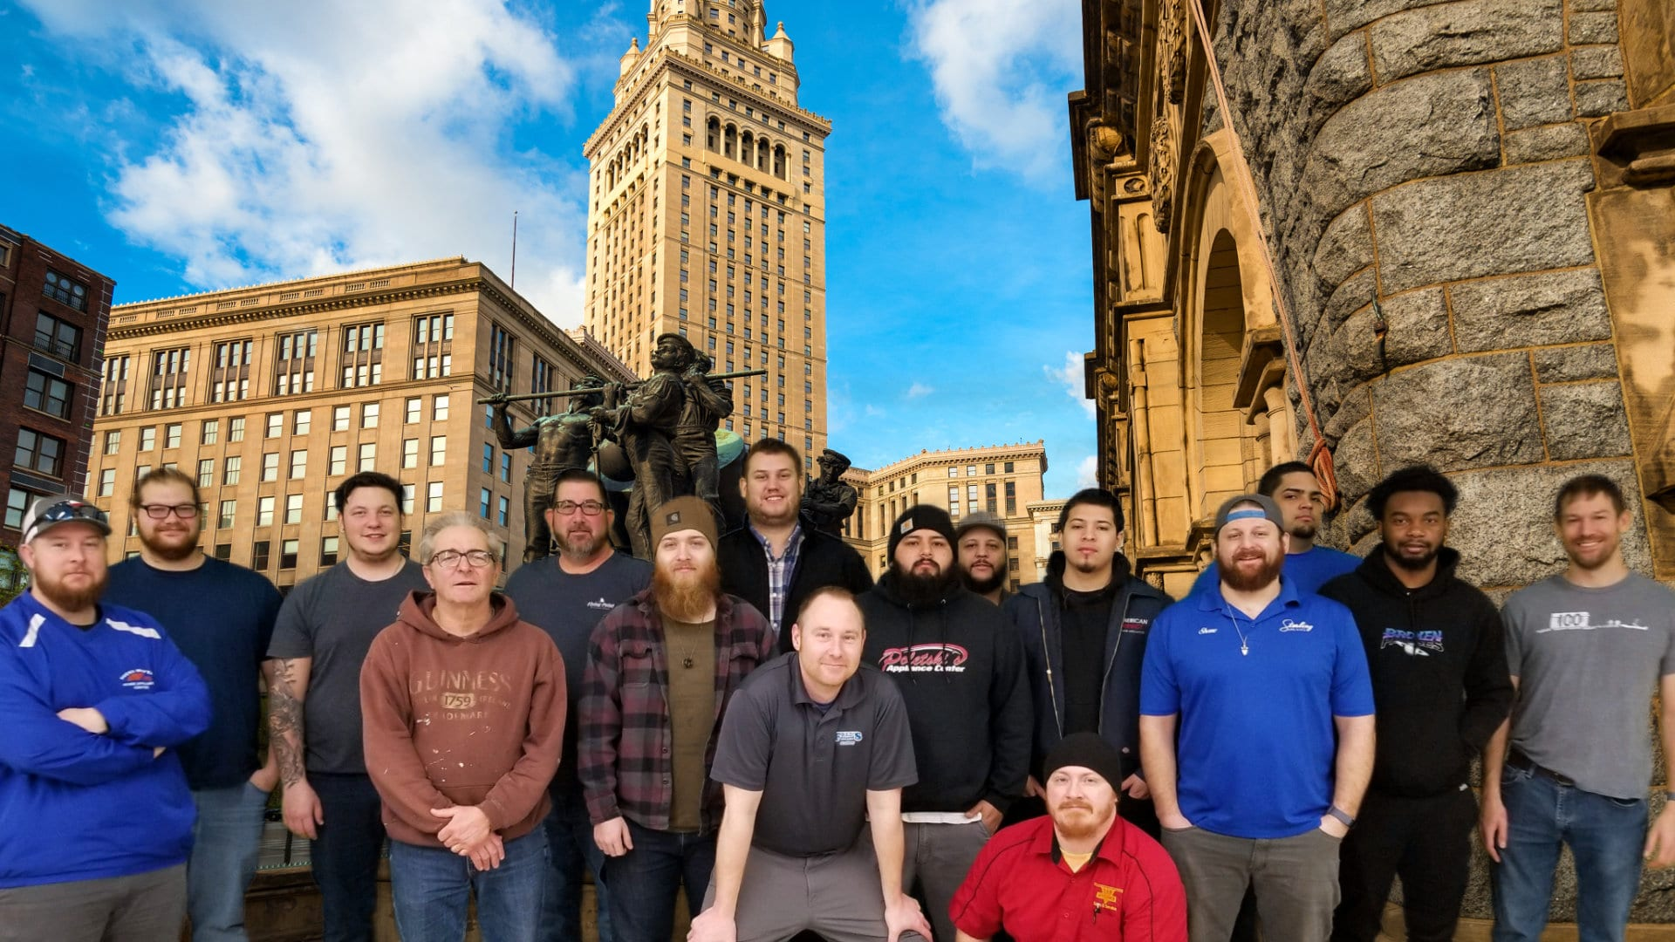
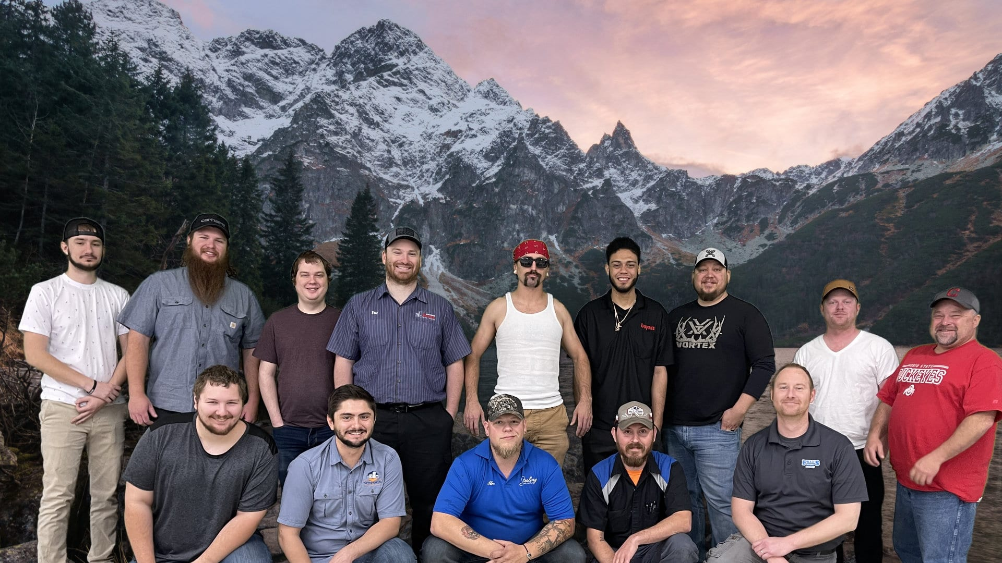
Using Fred’s Academy Hands-On Training with new hires
After at least 30 days of on the job training, we begin planning for attendance at Fred’s Appliance Academy Diagnostic & Repair Foundations.
Provides the basic fundamentals for appliance repair training to help candidates get time in a collaborative learning environment to flesh out diagnostic concepts without the stress of a customer leaning over your shoulder.
Learn with students from all around the world that travel to our location to get appliance repair training.
Hands-on training from instructors with real appliance repair experience.

Slide 17
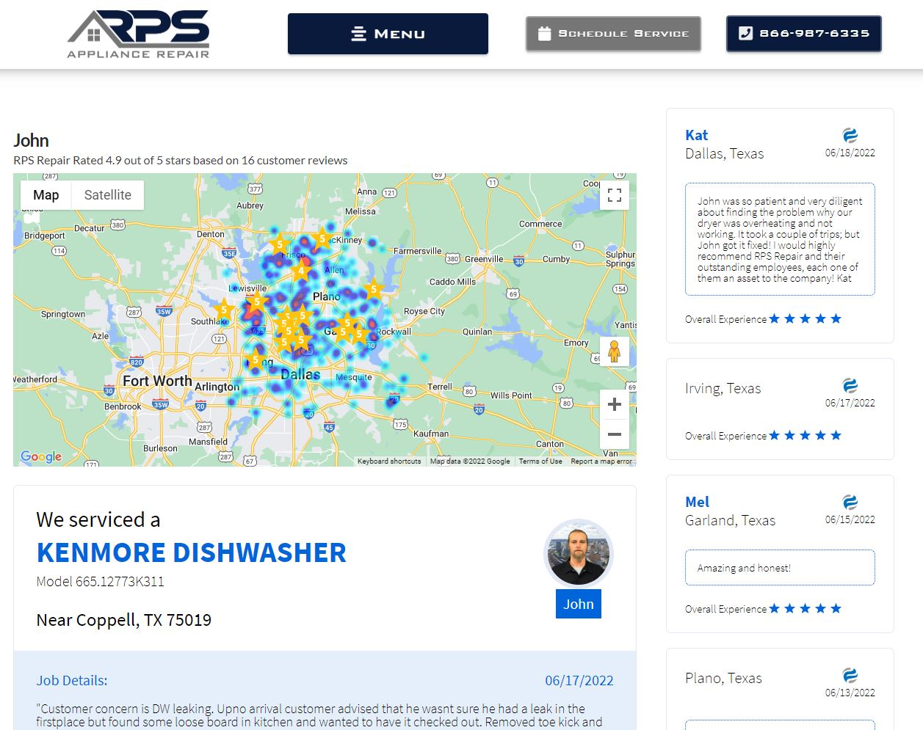
Fred’s Appliance Academy Alumni: John Cline @ RPS Repair rpsrepair.com/john
Attended Fred’s Academy
Hands-On Training
January 2022

Slide 19
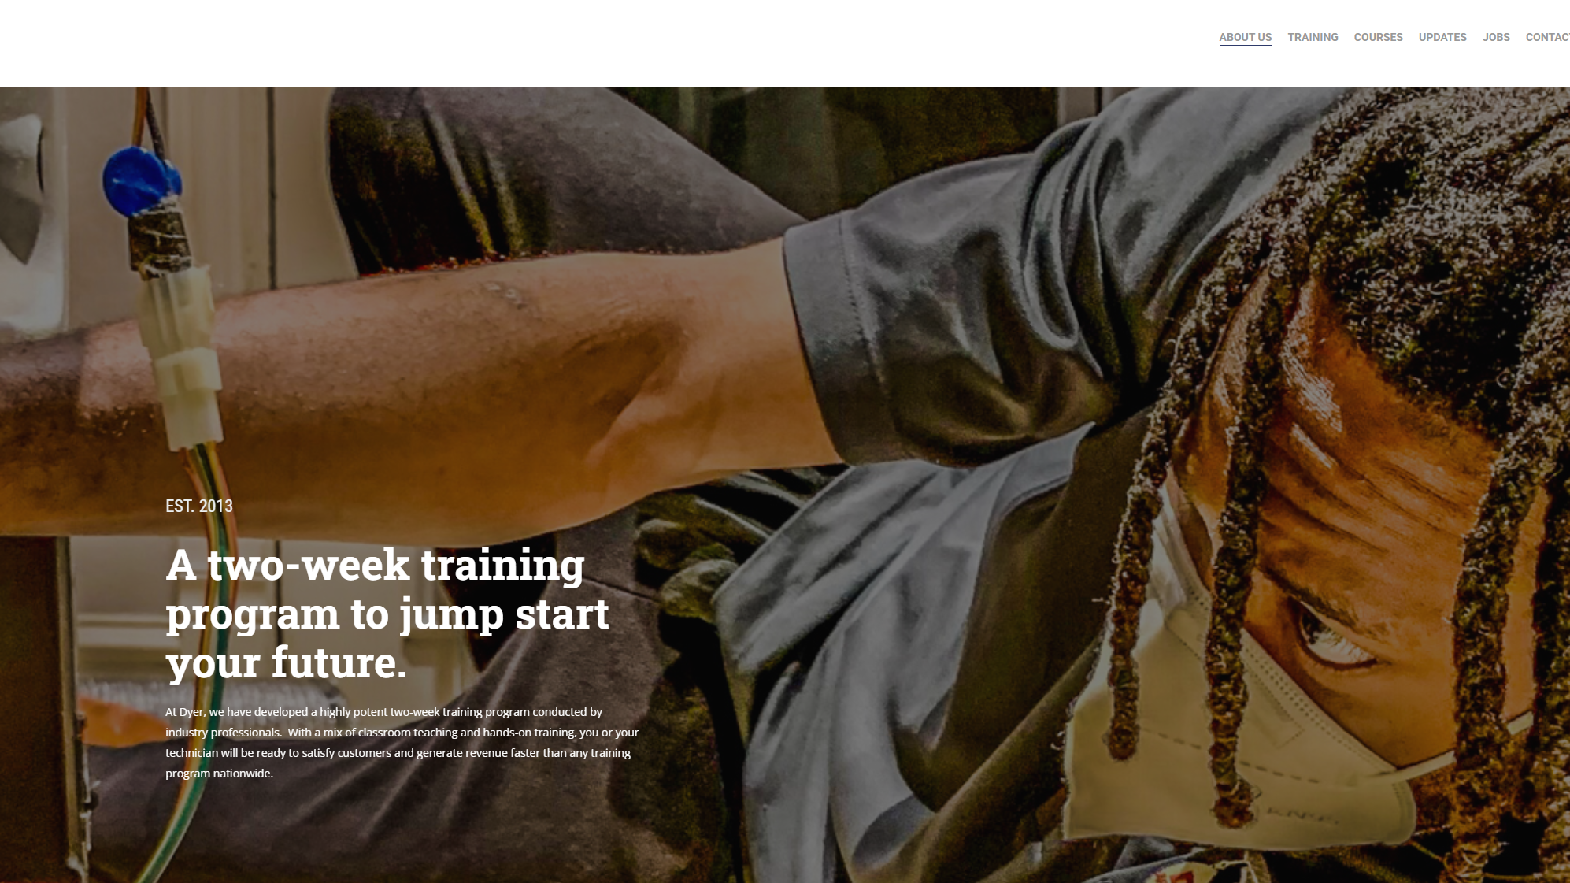

Slide 21
Theory, how & why
Soft Skills
Basic Electricity & Gas
Washer, Dryer
Dishwashers
Stoves, ovens & Cooktops
Refrigeration

Slide 23
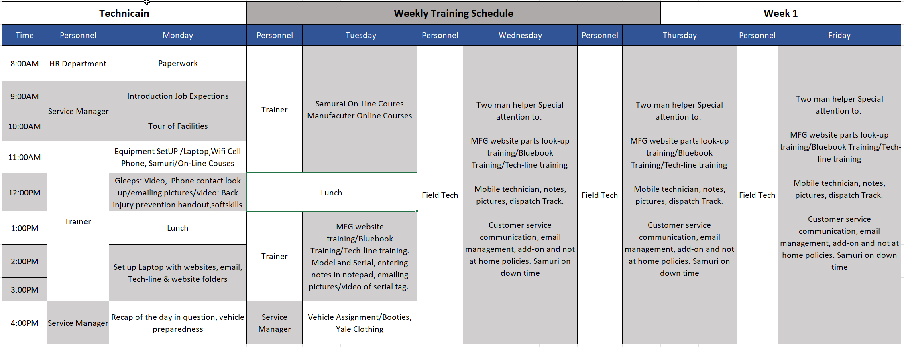

Slide 24
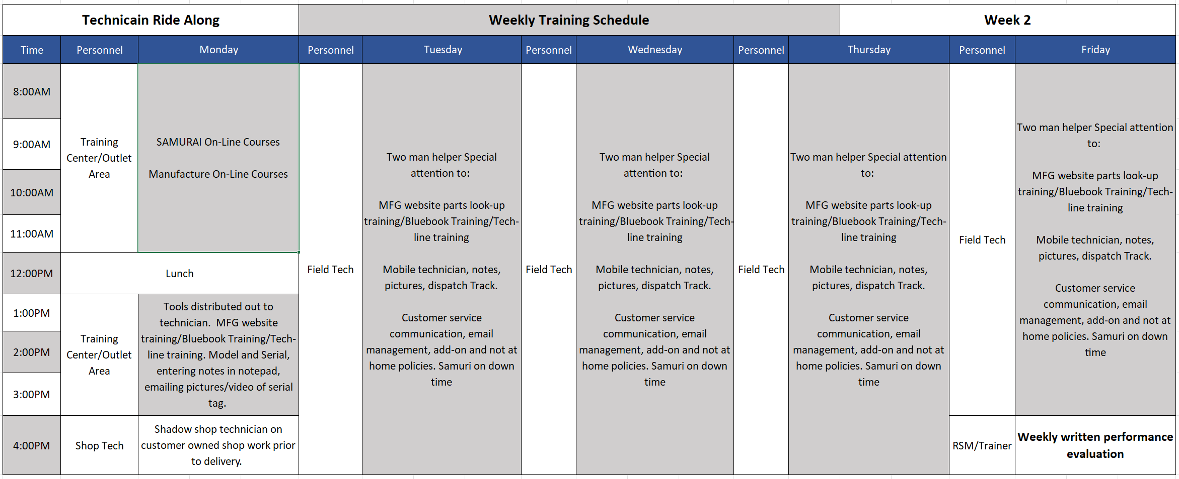

Slide 25
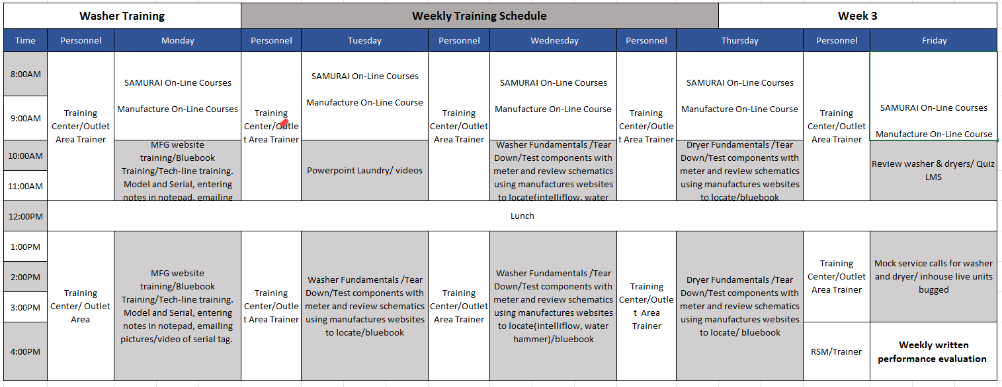

Slide 26
What caused the shortage of repair parts, and when will it end?
Should warranty service be profitable for SSDs? Yes or no, why?
1-800 tech support lines are essential but wait times are unacceptable. What is your company doing to improve this vital service?
SSDs are often not recognized as authorized by manufacturers' CS call centers. Would you consider a dedicated number for SSD to call for assistance on warranty calls?
Factory training too is essential. When will your company return to in-person, if not virtual technical training?
The warranty process in America is laborious and inefficient. Are you taking steps to improve it? Would your company consider a one-pay parts and labor reimbursement system?
Fist Call Completes are essential to customer satisfaction and service profits. Repair parts play a significant role in the repair cycle time. Having the proper inventory is a challenge for all. Would your company consider a repair parts program beneficial to all, such as the ability to exchange old parts stock for new?
What advice can you offer to help SSDs in their annual warranty rate negotiations?
Tuesday 7am - San Antonio 1

Slide 27
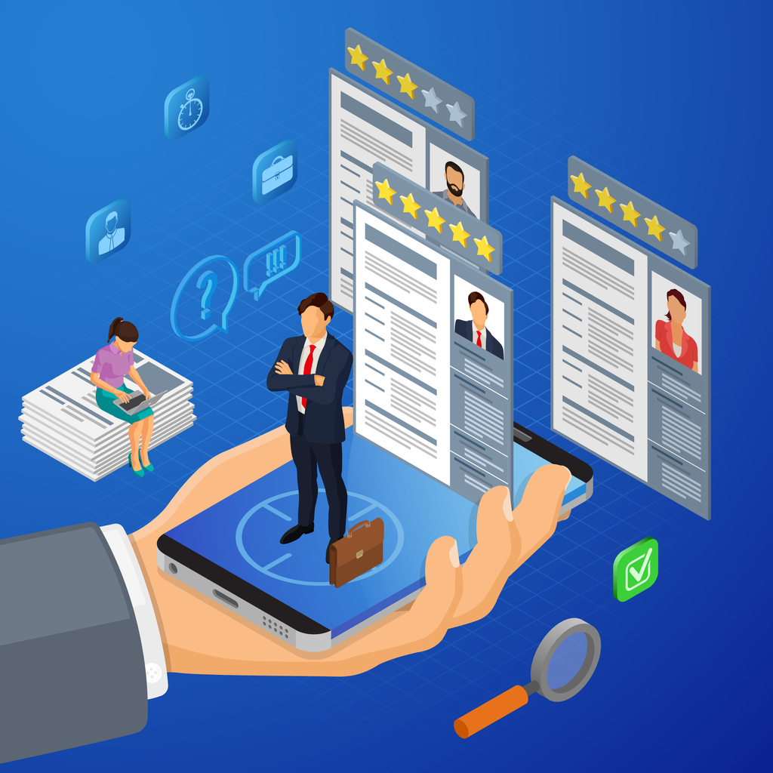
Service Resources
Facebook groups
BrandSource Service Dealer
Appliance Alliance
Appliance Pro Talk
United Servicers Association
Professional Service Association
Chat USA - $199/Yr.
Appliantology.org - $297/Yr.
YourSourceNews.com & ServiceSource Newsletter
Brand Source Service Play Book
Brand Source Service Scorecard
The Expert Service Program
Appliance Service Training Institute ASTI & NASC
YouTube - Free
ApplianceVideo.com - $39.99/Month
Notes:
Back in the late 80’s I would call around to competition
Most CEOs and CFOs add an arbitrary dollar amount and hope for the best

Slide 28
Open Discussion
Paul MacDonald
P 647-500-7785
E paul.m.macdonald@brandsource.com

