Slide 1


Warranty
Best Practices
SUMMIT 2022

Slide 2

Service
I have to!
Don’t fall into the trap!
  Selling any product or service must generate sustainable profits, or it's not a sound business strategy.

Slide 3


To a manufacturer warranty is a cost.
Their mandate is to
lower costs.

Slide 4


A service department provides a complete
end-to-end purchase experience for your customers.
When executed well, customers keep coming back.

Slide 5

Benefits of Warranty Service
Differentiates
Technical
Filler
Offer what the Big Box
can’t
New Model Training
Slow Season
Promote your service offering
Brand Alignment
1-800 Tech Hotline
Service Matters.com
Product Recalls
New Hire Training

Slide 6

Challenges of Warranty Service
Zero Margin Parts
Inefficient – often second trip with parts
After completed call, additional costs
Warranty claim process
Rejections – abandonment
Frustrations
The more efficient a service operation, the more profits it will enjoy.
Efficiency is directly tied to billable hours in service.

Slide 7
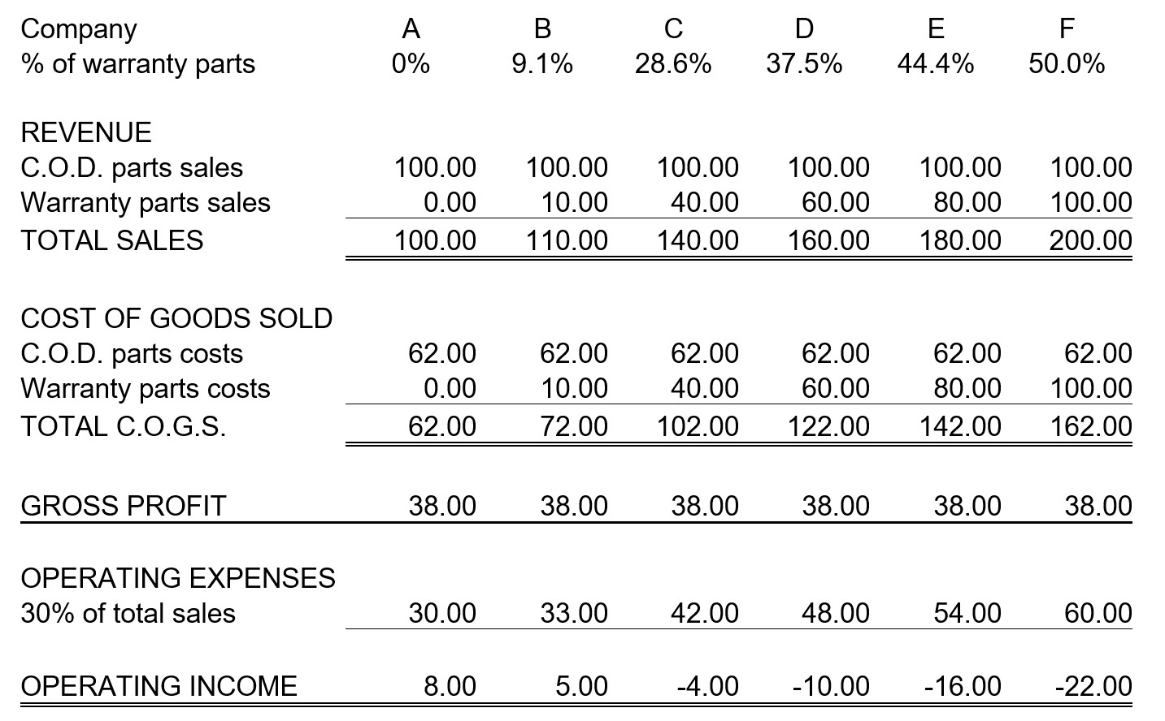

Profits Decrease as Warranty % Increases
Company A = 0% Warranty
Company F = 50% Warranty

Slide 8
Optimal Ratio Warranty : COD
30:70
How:
Sustain Warranty
Grow COD Service

Slide 9

Warranty Best Practices
Janice Salmon, President & Founder
Jim Rushton, Business Partner

Slide 10
Present State – Direct Portal Claims Entry or via Business Management Software
Platform Portal | OEM/TPA’s Supported
ServicePower | GE, LG, Electrolux, BSH, AIG
ServiceBench | Whirlpool, Carrier Enterprise, Sharp, Samsung (limited), Lowes, Cinch, HomeServe
NSA | Self supporting
Samsung GSPN | Samsung, Dacor
LG | LG
Alliance Laundry | Speed Queen
ServiceLive | Self supporting TPA
Fidelity | Self supporting TPA
OnPoint | Self Supporting TPA
New Leaf | Self supporting TPA using CSGI connected to SP/SB
AHS | Self Supporting TPA
Cinch Home Services | Using ServiceBench
Davisware | HVAC, Appliance
Dispatch.me | Multi Industry
Servicer Software | User Industries
CDA | Appliances, HVAC
Davisware | HVAC
ePASS | Appliances
FieldEdge | Appliance, Electrical, HVAC, Plumbing
Housecall Pro | Appliances, Electrical, HVAC, Plumbing
GetJobber | HVAC, Plumbing
Service Works | Appliances, Electrical, HVAC, Pest Control, Plumbing
ServiceDesk | Appliances,
ServiceBench BMS | Appliances, TPA
ServicePower Hub | Appliances, TPA
Service Titan | Electrical, HVAC, Plumbing, Pest Control
WalkAbout | Appliances
Workiz | Appliances, Electrical, HVAC, Plumbing
Notes:
If you are using FSM claims data is moving in many directions.

Slide 11
Our Experience with Claims Processing
Difficulty understanding Rejection Messages; Examples: Duplicate Document, Approval total 0, Description/Failure Incomplete, Cosmetic Warranty not covered
New Rejection Messages; Customer Last Names do not Match
No Contact with the Manufacturer or Portal: Getting a clear explanation as to “how” to correct the rejections messages mentioned above
Part Rejections
No parts were verified by distributor – who has the answer the manufacturer or the PD?
Truck stock – technicians need to know the PD and the Invoice #
How to process parts supplied by the manufacturer
Inactive Part Number – what is the new substitute part number?

Slide 12
Our Experience with Claims Processing
Know your Time Limits by Manufacturer
How long do you have to file a claim after its completed?
How long do you have to fix a rejected claim after it is filed?
How long do you have to file a claim for customer education?
How long do you have to file a installation claim?
When does your authorization/concession expire?
When does your parts distributor invoice expire?
Do any of your parts have an extended warranty?
The Value of the Purchase Date; most important field on a warranty claim because it calculates the warranty coverage; Missing Purchase Date, Invalid Purchase Date, Purchase Date Changed, Out of Warranty, Purchase Date Too Early, etc.

Slide 13

Warranty Best Practices – Top 10
File Claims in a Timely Manner
Check the Status of your claims Frequently
When Ordering Parts Note Customers Last Name on Order
Note in Service Performed if job is a Recall/Callback
Take Pictures of the Customer’s Proof of Purchase
Encourage Customers to Register their Products
Use Entitlement to verify Warranty Eligibility – don’t take it for granted from call centers
Always use the full engineering model number - not the sales model number
Include initial product issue in the Service Performed
Never file a claim without the Parts Distributor, Parts Invoice# and Exact Price

Slide 14

Notes:
https://www.youtube.com/watch?v=4l8d7NukiCE

Slide 15
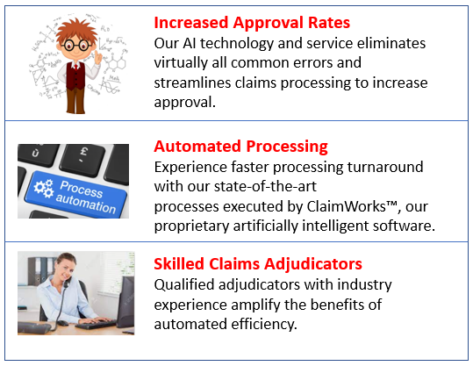

Thank you
SUMMIT 2022

